Slide 1
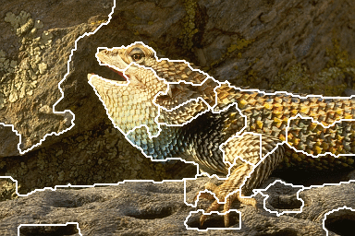
Graph-based Image Segmentation
Computer Vision & Pattern Recognition

Slide 2
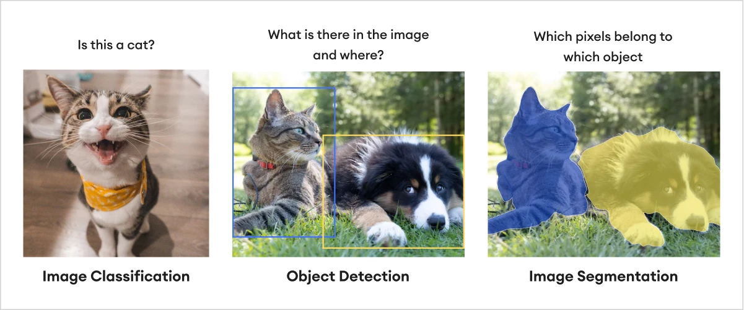
What is image segmentation?
image segmentation is essentially segmenting an image into fragments and assigning a label to each of those.
This occurs on a pixel level to define the precise outline of an object within its frame and class.

Slide 3
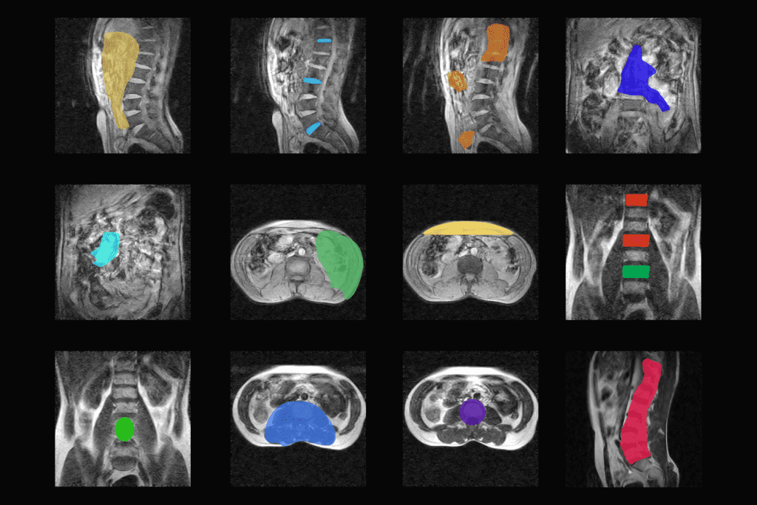
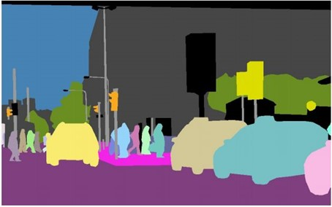
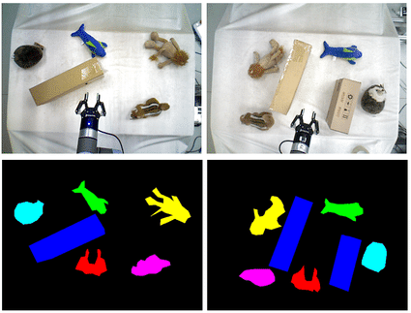
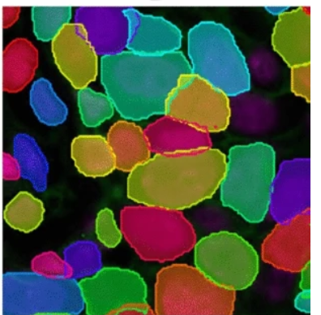
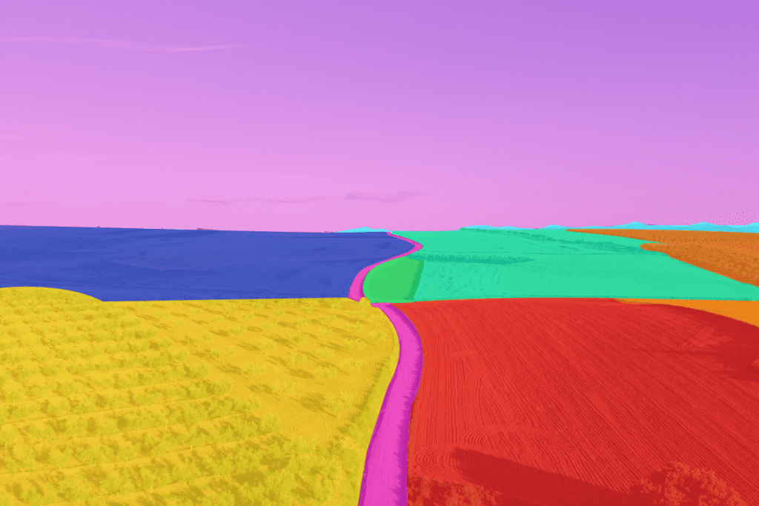
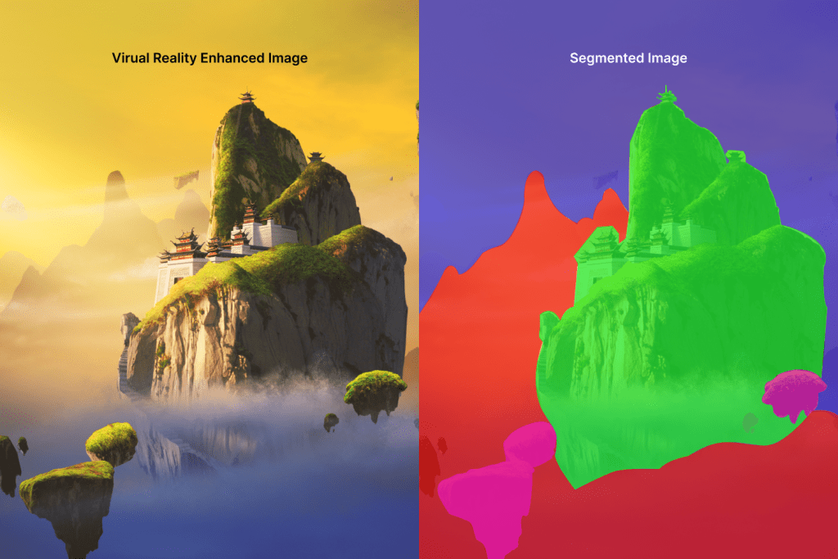
What is image segmentation used for?
Medical imaging
Autonomous vehicles
Robot Manipulation
Crop yield estimation
Virtual reality
Cell segmentation
Notes:
影像分割可用于通过分析农作物的植被指数来估计农作物产量。植被指数是使用农作物的光谱反射率计算的，这可以通过遥感进行测量。然后可以将图像分割技术应用于这些图像以识别和计算作物，从而可以准确估计作物产量。
杂草检测是图像分割在农业中的另一个重要应用。传统的杂草检测方法涉及体力劳动，耗时。图像分割技术可以帮助农民实时检测杂草，使他们能够及时采取行动清除杂草。
在游戏行业，图像分割用于创建逼真的沉浸式游戏环境。该技术用于分离游戏元素，例如角色、对象和背景。这允许游戏开发人员独立作每个组件，从而产生更具动态性和交互性的游戏。图像分割还用于检测和跟踪玩家的移动，这对于需要运动控制的游戏至关重要。
图像分割在 VR 中用于创建逼真的交互式虚拟环境。该技术用于将虚拟对象与背景分离，从而为用户提供更加身临其境的体验。图像分割还在 VR 中用于手势识别，允许用户使用手部动作与虚拟对象进行交互。
使用多重免疫荧光 （MxIF） 图像进行细胞分析有助于更准确地对免疫治疗进行患者分层。
免疫肿瘤学分析需要对肿瘤微环境进行详细评估¹。这包括识别和定量不同的免疫细胞亚群、它们的空间排列以及这些细胞上免疫检查点标志物的表达²。同时表征免疫和肿瘤相关通路可以更准确地为免疫治疗进行患者分层 ^{3,4,5}。成像和自动分析（包括人工智能）的进步会极大地影响执行此类表征的能力¹。

Slide 4
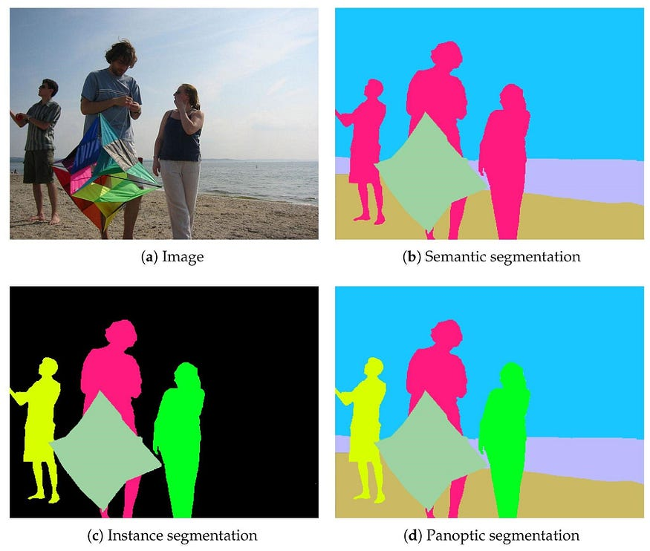
Types of image segmentation
Image segmentation can further be divided into the following categories :
instance segmentation
semantic segmentation
panoptic segmentation
The difference between semantic vs. instance vs. panoptic segmentation lies in how they process the things and stuff in the image.
Notes:
全景分割（Panoptic Segmentation）：
您可以把它想象成给图片中的每一个小点（像素）都打上两个标签：一个是它属于什么类别（比如是车、人还是树），另一个是它是哪个具体的物体（比如是第1辆车还是第2辆车）。
图片里的东西被分成两大类：
事物（Things）：这些是可以数得清的、有明确形状的物体，比如车、人、狗等。每个物体都有自己的边界，并且被单独标记。
背景（Stuff）：这些是没法数的、没有明确形状的区域，比如天空、草地、墙壁等。它们通常被看作一个整体，没有单独的标记。
语义分割（Semantic Segmentation）：
这个只给每个像素打一个类别标签，比如所有车都标记为“车”，但不会区分是第1辆车还是第2辆车。它只关心“这是什么”，不关心“这是哪个”。
实例分割（Instance Segmentation）：
这个不仅要给每个物体打上类别标签，还要区分同一类别中的不同个体。比如，它会告诉您这是第1辆车，那是第2辆车，并且给每个物体画出一个单独的轮廓或框。
总结一下：
语义分割：只告诉您“这是什么”。
实例分割：告诉您“这是什么”并且“这是哪个”。
全景分割：结合了语义分割和实例分割，既告诉您“这是什么”，也告诉您“这是哪个”，并且还处理了背景区域。

Slide 5
Image segmentation techniques
Traditional
Region base
Thresholding
Edge detection
Clustering
Deep Learning
U net
Mask R CNN
DeepLab
Interactive segmentation
SAM

Slide 6
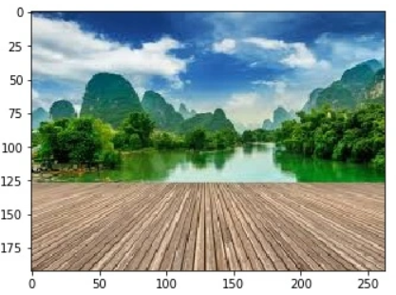
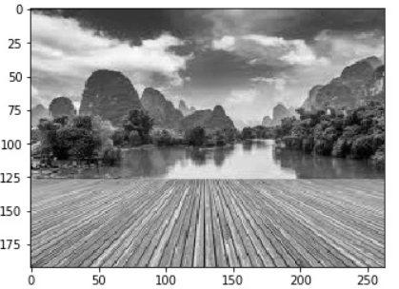
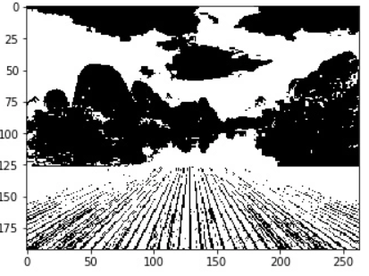
Traditional image segmentation
Threshold-based segmentation is one of the simplest and most commonly used techniques.
When the object and background have high contrast, this method performs well

Slide 7
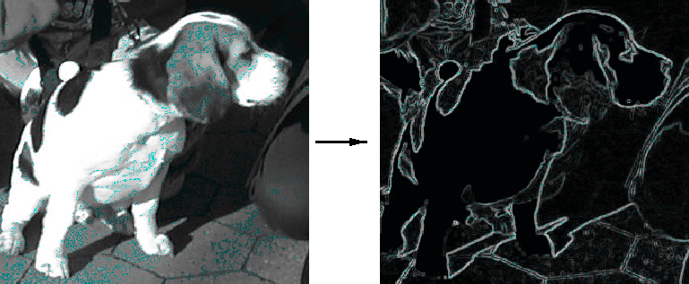
Traditional image segmentation
Edge-based segmentation techniques focus on detecting and utilizing the edges in an image to define object boundaries.
Edges represent significant changes in pixel intensities and can be detected using edge detection algorithms such as Sobel, Canny, and Laplacian of Gaussian.
Sensitive to noise and requires well-defined edges.

Slide 8
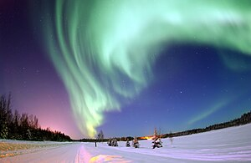

Traditional image segmentation
Clustering-based segmentation groups pixels depending on their color, texture, or other characteristics. k-means and hierarchical clustering are two popular clustering algorithms.
The quality of the solution depends on the initial set of clusters and the value of K.
Source image.
Image after running k-means with k = 16.

Slide 9
Traditional image segmentation
Region-based segmentation techniques divide an image into meaningful regions by considering both local and global information. Techniques such as graph-based segmentation is frequently used in this approach.
Graph Cuts leverages graph theory to minimize an energy function based on pixel similarities and dissimilarities.

Slide 10
Deep Learning image segmentation
Mask R-CNN is a two-stage convolutional neural network that efficiently generates instance segmentation masks, bounding boxes, and classifications by using a Region Proposal Network (RPN) followed by region-based parallel processing.
Interactive segmentation is a deep learning segmentation technique. the user should provide pixels for segmentation. Then the model outputs the instance segmentation based on the image and provides input points.
Segment Anything Model (SAM) is developed by Meta and trained on 1 billion masks, enables non-experts to perform accurate image segmentation and is effective for complex tasks like medical and satellite image analysis.

Slide 11
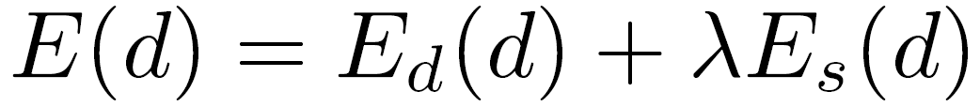
A minimization problem
{
{
match cost
smoothness cost
Want each pixel to find a good match in the other image
Adjacent pixels should (usually) move about the same amount

Slide 12
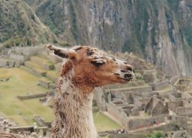
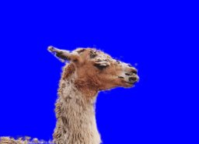
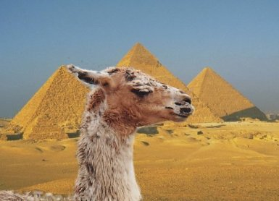
Related problem: binary segmentation
Suppose we want to segment an image into foreground and background
Can you think of a way to solve this problem?

Slide 13
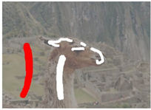
Related problem: binary segmentation
Suppose we want to segment an image into foreground and background
User sketches out a few strokes on foreground and background…
How do we classify the rest of the pixels?

Slide 14
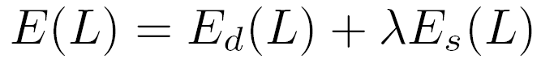
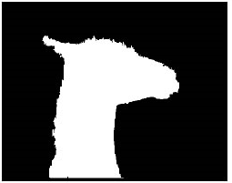
Binary segmentation as energy minimization
Define a labeling L as an assignment of each pixel with a 0-1 label (background or foreground)
Problem statement: find the labeling L that minimizes
{
{
match cost
smoothness cost
(“how similar is each labeled pixel to the foreground / background?”)

Slide 15
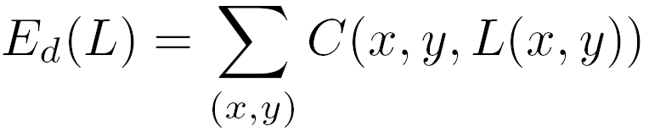
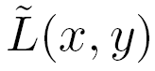
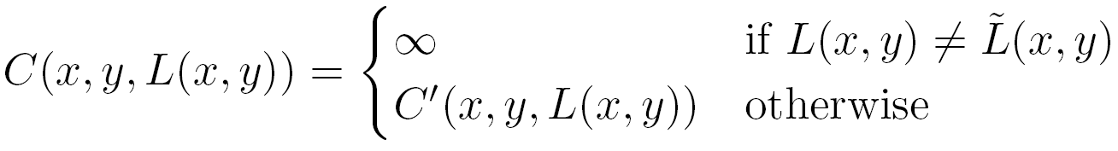
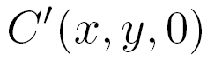
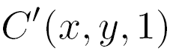
: “distance” from pixel to background pixels
{
usually computed by creating a color model from user-labeled pixels
: “distance” from pixel to foreground pixels
Notes:
(x,y)代表一个像素

Slide 16
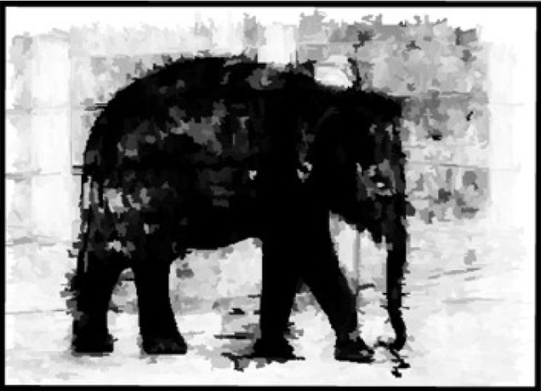
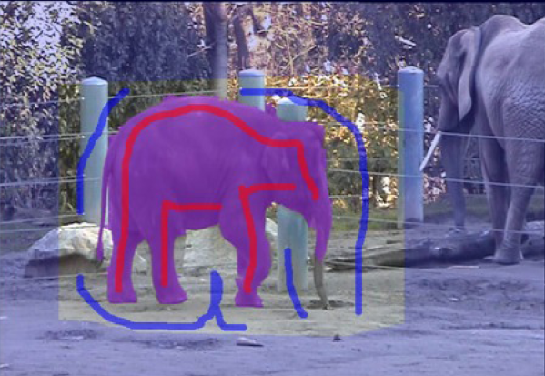
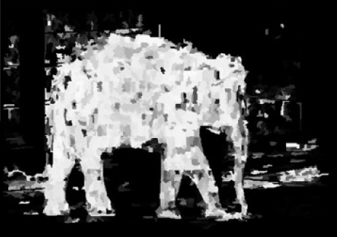

Slide 17
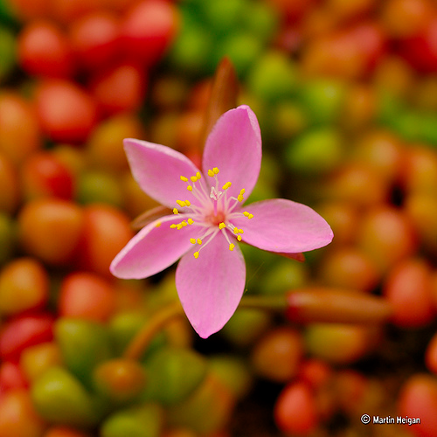
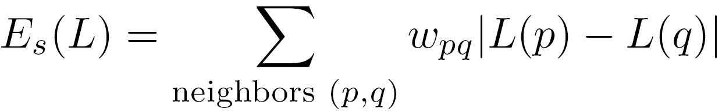
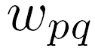
Neighboring pixels should generally have the same labels
Unless the pixels have very different intensities
: similarity in intensity of p and q
= 10.0
= 0.1

Slide 18
Binary segmentation as energy minimization
For this problem, we can easily find the global minimum!
Use max flow / min cut algorithm

Slide 19
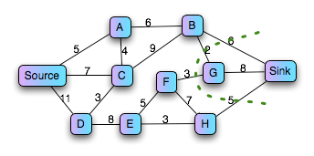

Graph min cut problem
Given a weighted graph G with source and sink nodes (s and t), partition the nodes into two sets, S and T such that the sum of edge weights spanning the partition is minimized
and s S and t T

Slide 20

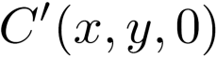
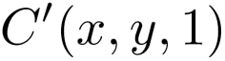
Segmentation by min cut
min cut
t
(“background”)
s (“foreground”)
Graph
node for each pixel, link between adjacent pixels
specify a few pixels as foreground and background
create an infinite cost link from each bg pixel to the t node
create an infinite cost link from each fg pixel to the s node
create finite cost links from s and t to each other node
compute min cut that separates s from t
The min-cut max-flow theorem [Ford and Fulkerson 1956]

Slide 21
Segmentation by min cut
min cut
t
s
The partitions S and T formed by the min cut give the optimal foreground and background segmentation
I.e., the resulting labels minimize

Slide 22
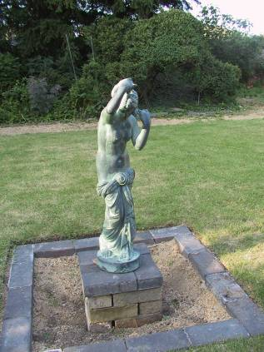
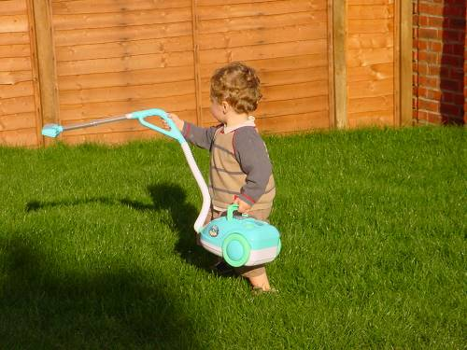
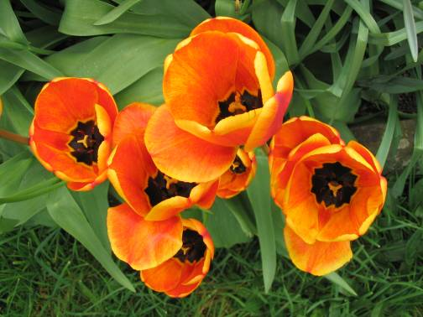
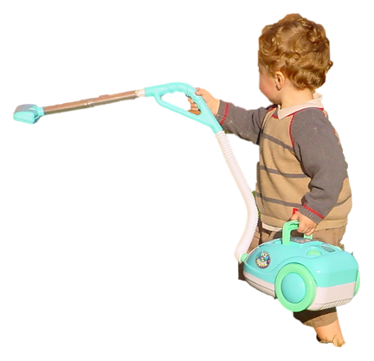
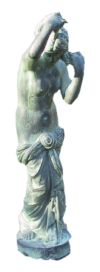

GrabCut
Grabcut [Rother et al., SIGGRAPH 2004]

Slide 23
Is user-input required?
Our visual system is proof that automatic methods are possible
classical image segmentation methods are automatic
Argument for user-directed methods?
only user knows desired scale/object of interest

Slide 24
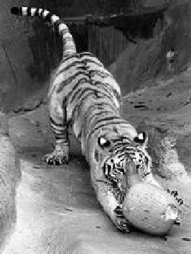
Automatic graph cut [Shi & Malik]
q
C_{pq}
p
c
Fully-connected graph
node for every pixel
link between every pair of pixels, p,q
cost c_{pq} for each link
c_{pq} measures similarity
similarity is inversely proportional to difference in color and position

Slide 25
Segmentation by Graph Cuts
w
A
B
C
Break Graph into Segments
Delete links that cross between segments
Easiest to break links that have low cost (similarity)
similar pixels should be in the same segments
dissimilar pixels should be in different segments

Slide 26
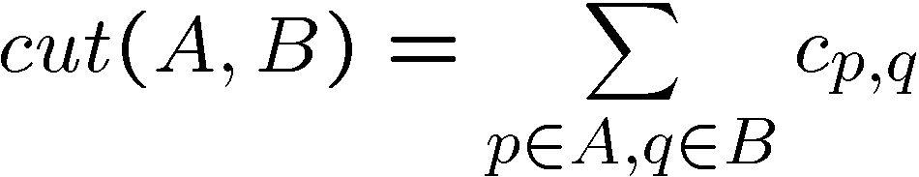
Cuts in a graph
B
A
Link Cut
set of links whose removal makes a graph disconnected
cost of a cut:
Find minimum cut
gives you a segmentation

Slide 27
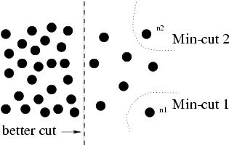
But min cut is not always the best cut...

Slide 28
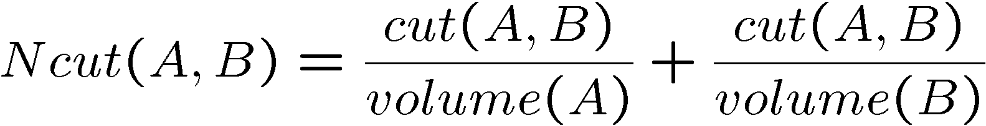
Cuts in a graph
B
A
Normalized Cut
a cut penalizes large segments
fix by normalizing for size of segments
volume(A) = sum of costs of all edges that touch A

Slide 29
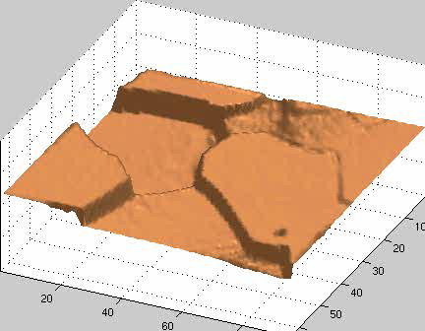
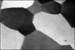
Interpretation as a Dynamical System
Treat the links as springs and shake the system
elasticity proportional to cost
vibration “modes” correspond to segments
can compute these by solving an eigenvector problem
http://www.cis.upenn.edu/~jshi/papers/pami_ncut.pdf

Slide 30
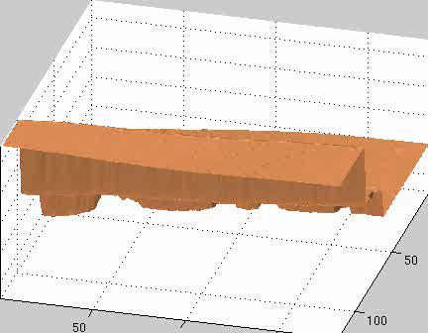
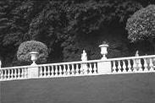
Interpretation as a Dynamical System
Treat the links as springs and shake the system
elasticity proportional to cost
vibration “modes” correspond to segments
can compute these by solving an eigenvector problem
http://www.cis.upenn.edu/~jshi/papers/pami_ncut.pdf

Slide 31
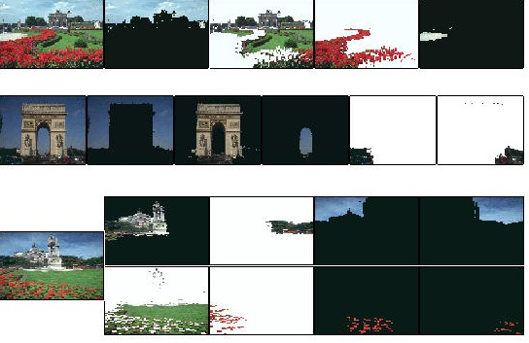
Color Image Segmentation

Slide 32


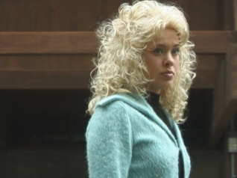






Extension to Soft Segmentation
Each pixel is convex combination of segments. Levin et al. 2006
- compute mattes by solving eigenvector problem

Slide 33
Questions?

Slide 34

A case…

Slide 35


Atmospheric Scattering Model

Slide 36


Dark Channel Prior
Through statistical analysis, He observed that in haze-free natural images, at least one color channel within a local region tends to have pixel values close to zero.
这两个最小操作是可交换的，最终得到的结果是该局部区域内的“最暗值”。
如果给出一张户外无雾图像（除天空或者明亮的白色区域），其暗通道的强度通常很低，并且趋向于零：

Slide 37

Algorithm Steps
(1) Estimating Atmospheric Light
在之前的去雾算法中，通常将图像中最“雾浓”的区域颜色视为大气光 A 或其初始值。然而，如何准确检测“最雾浓”区域并未得到充分关注。
传统方法的局限性：
Tan 的方法认为图像中最亮的像素是“最雾浓”的区域，但这仅适用于阴天（忽略阳光）的情况。
在实际场景中，阳光的影响不可忽略，因此图像中最亮的像素可能比大气光更亮（例如白色汽车或建筑物）。
改进方法 ：
利用暗通道先验：暗通道可以近似反映雾的浓度。通过暗通道，选择暗通道中最亮的前 0.1% 像素，这些像素通常对应“最雾浓”区域。在这些像素中，进一步选择对应原图中亮度最高的像素作为大气光 A。

Slide 38


Slide 39




Algorithm Steps
(2) Estimating the Transmission
目前给定图像I，就可以根据其暗通道直接估计 A，还需要估计一个t。
将图像亮度“标准化”，消除大气光 A 的影响，便于后续分析。
根据暗通道先验，无雾图像 的暗通道趋近于0。于是：
公式两边取暗通道操作（即局部区域内，三个颜色通道的最小值）：

Slide 40



Algorithm Steps
(2) Estimating the Transmission
最终透射率公式：
直观理解：
特殊情况：

Slide 41

Algorithm Steps
(3) Recovering Haze-Free Image
直接恢复的场景辐射度 J 容易出现噪点（浓雾区域t≈0，计算不稳定，容易引入噪声，因此设置了下界t0）

Slide 42

Haze removal results.

Slide 43
Questions?

